Slide 1
G2M Insight for Cab Investment Firm
18 July, 2022

Slide 2
Agenda
Executive Summary
Problem Statement
Approach
EDA
EDA Summary
Recommendations

Slide 3
Summary:
XYZ, a private firm in the U.S. plans to invest in the Cab industry after industry growth
Cab Companies: Yellow Cab vs. Pink Cab
Performed EDA, Data Visualization, Cleaning, & Manipulating

Slide 4
DataSets Used
Cab_Data.csv – this file contains details of transactions for 2 Cab companies
Customer_ID.csv – this file contains unique identifiers which link to the customer’s demographic information.
Transaction_ID.csv – this file contains transaction details (payment mode etc.)
City.csv – this file contains all the U.S. cities where customers have used the cab services and their population

Slide 5
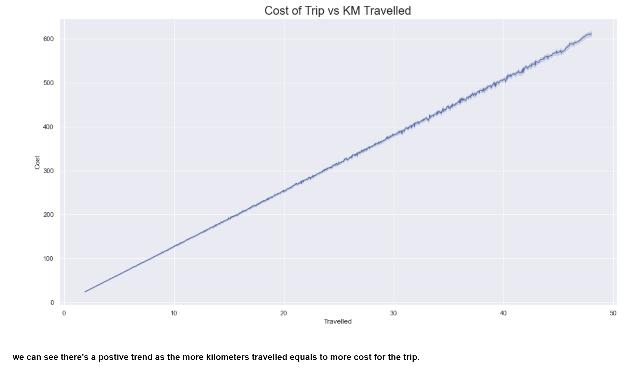
Cost of Trip Vs KM Travelled

Slide 6
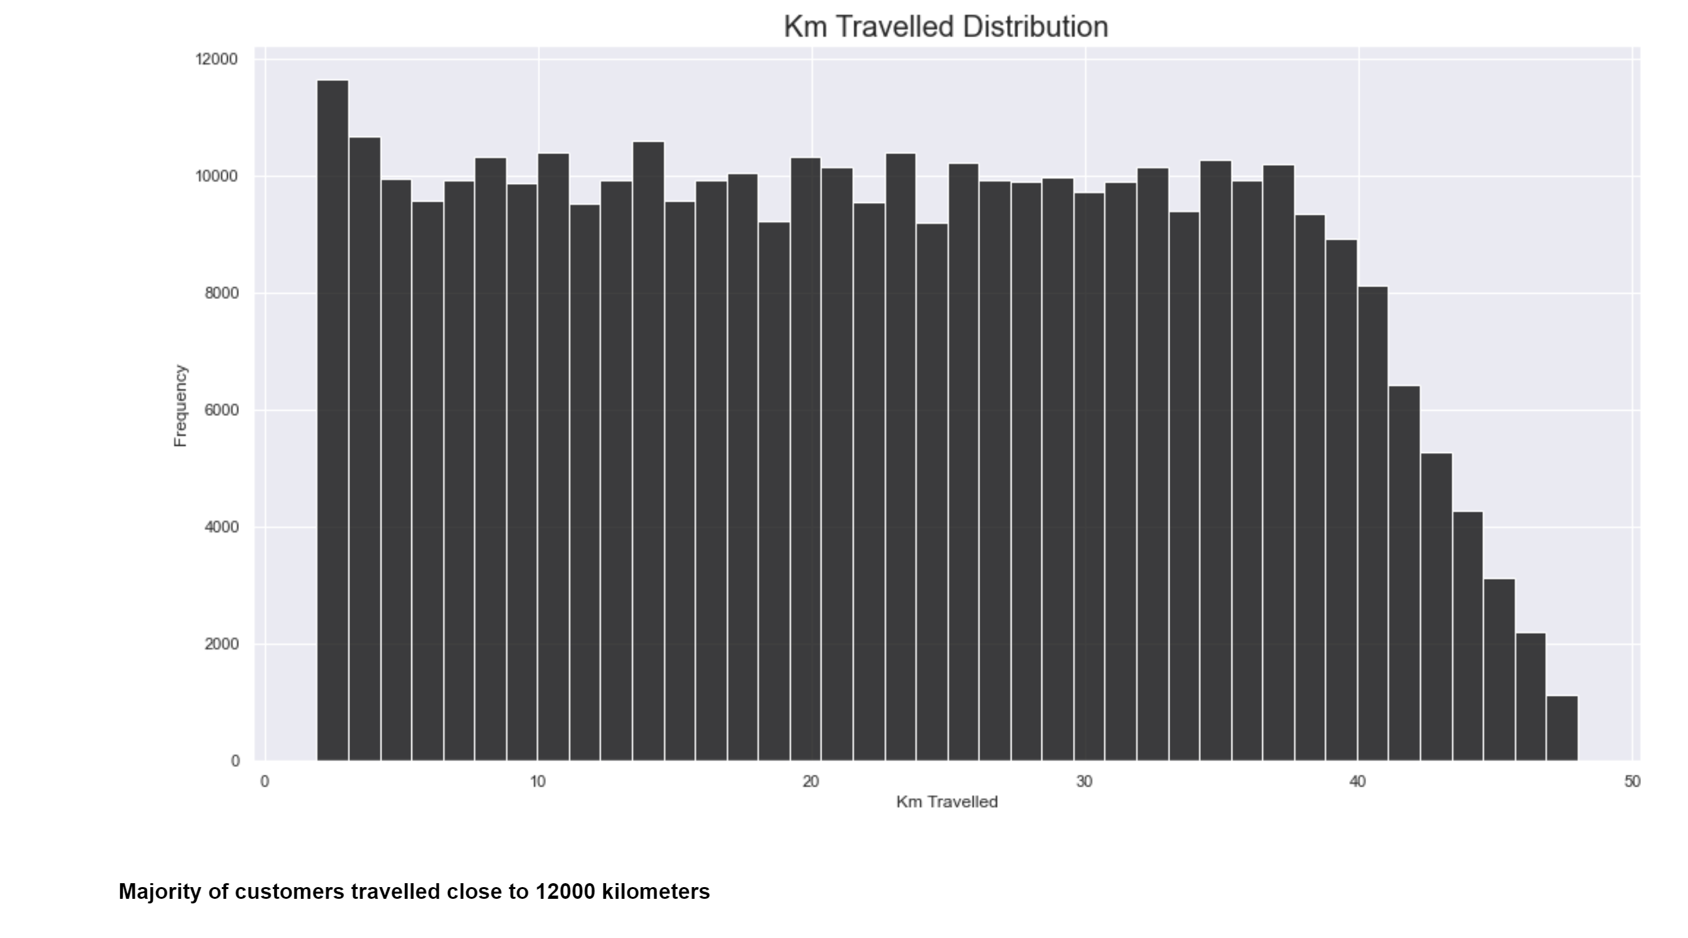
Distribution of KM Travelled

Slide 7
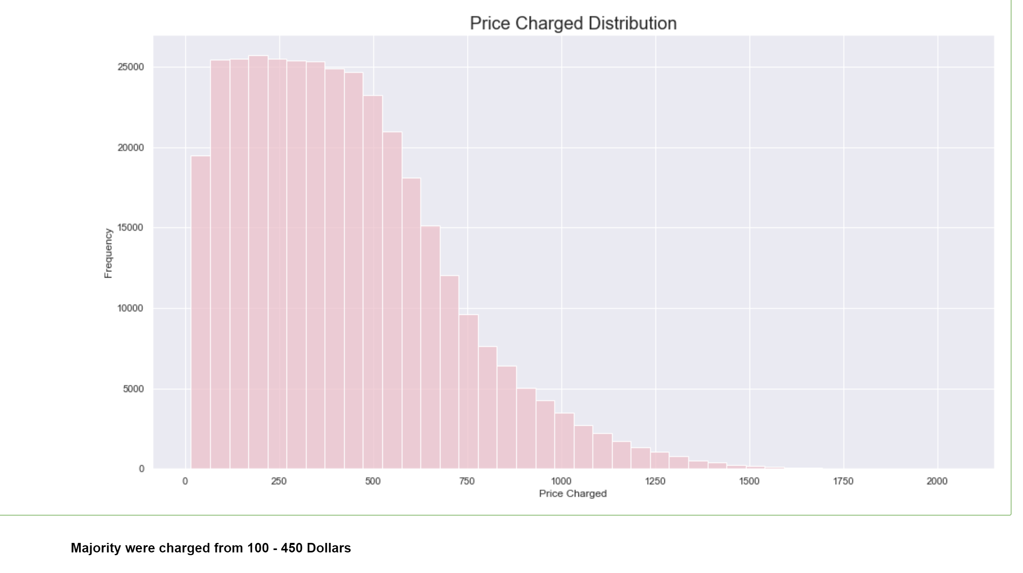
Distribution of Price Charged

Slide 8
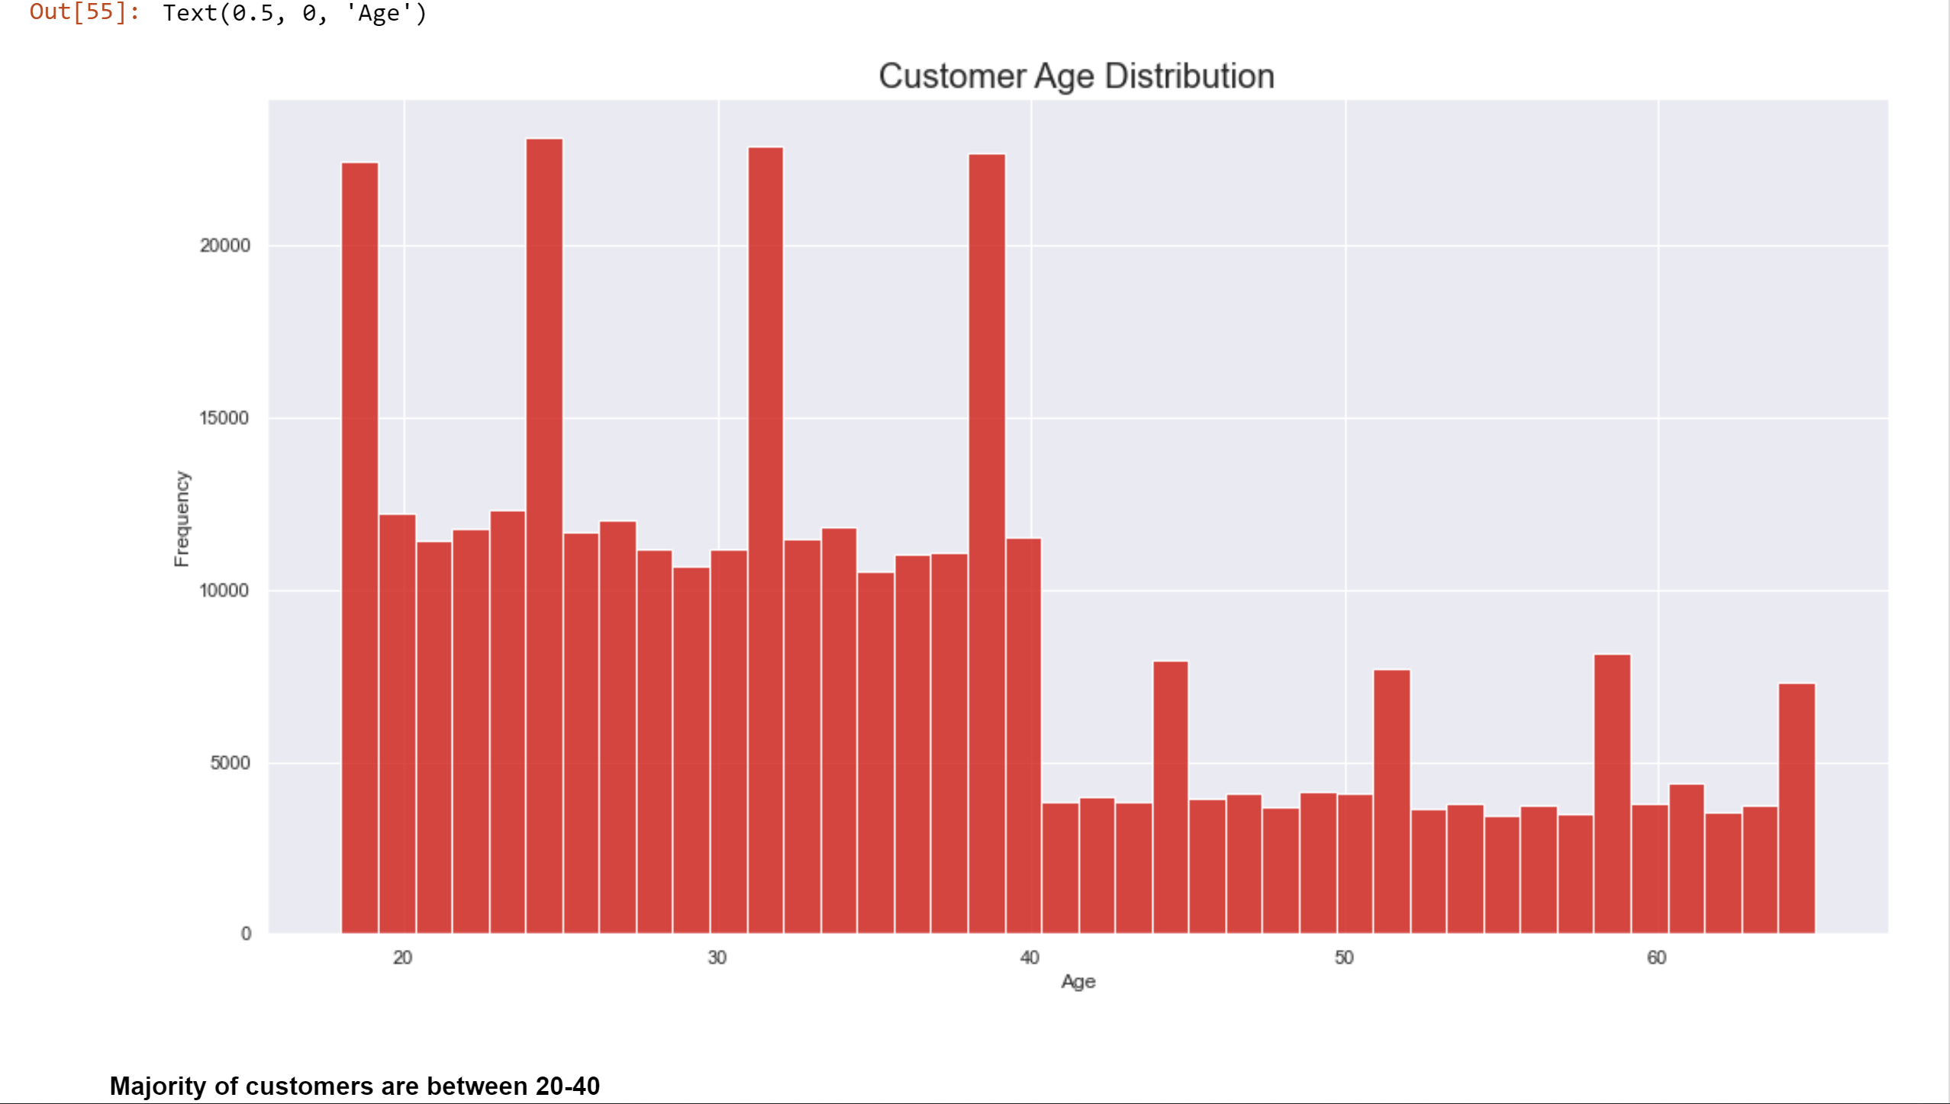
Distribution of Customer Age

Slide 9
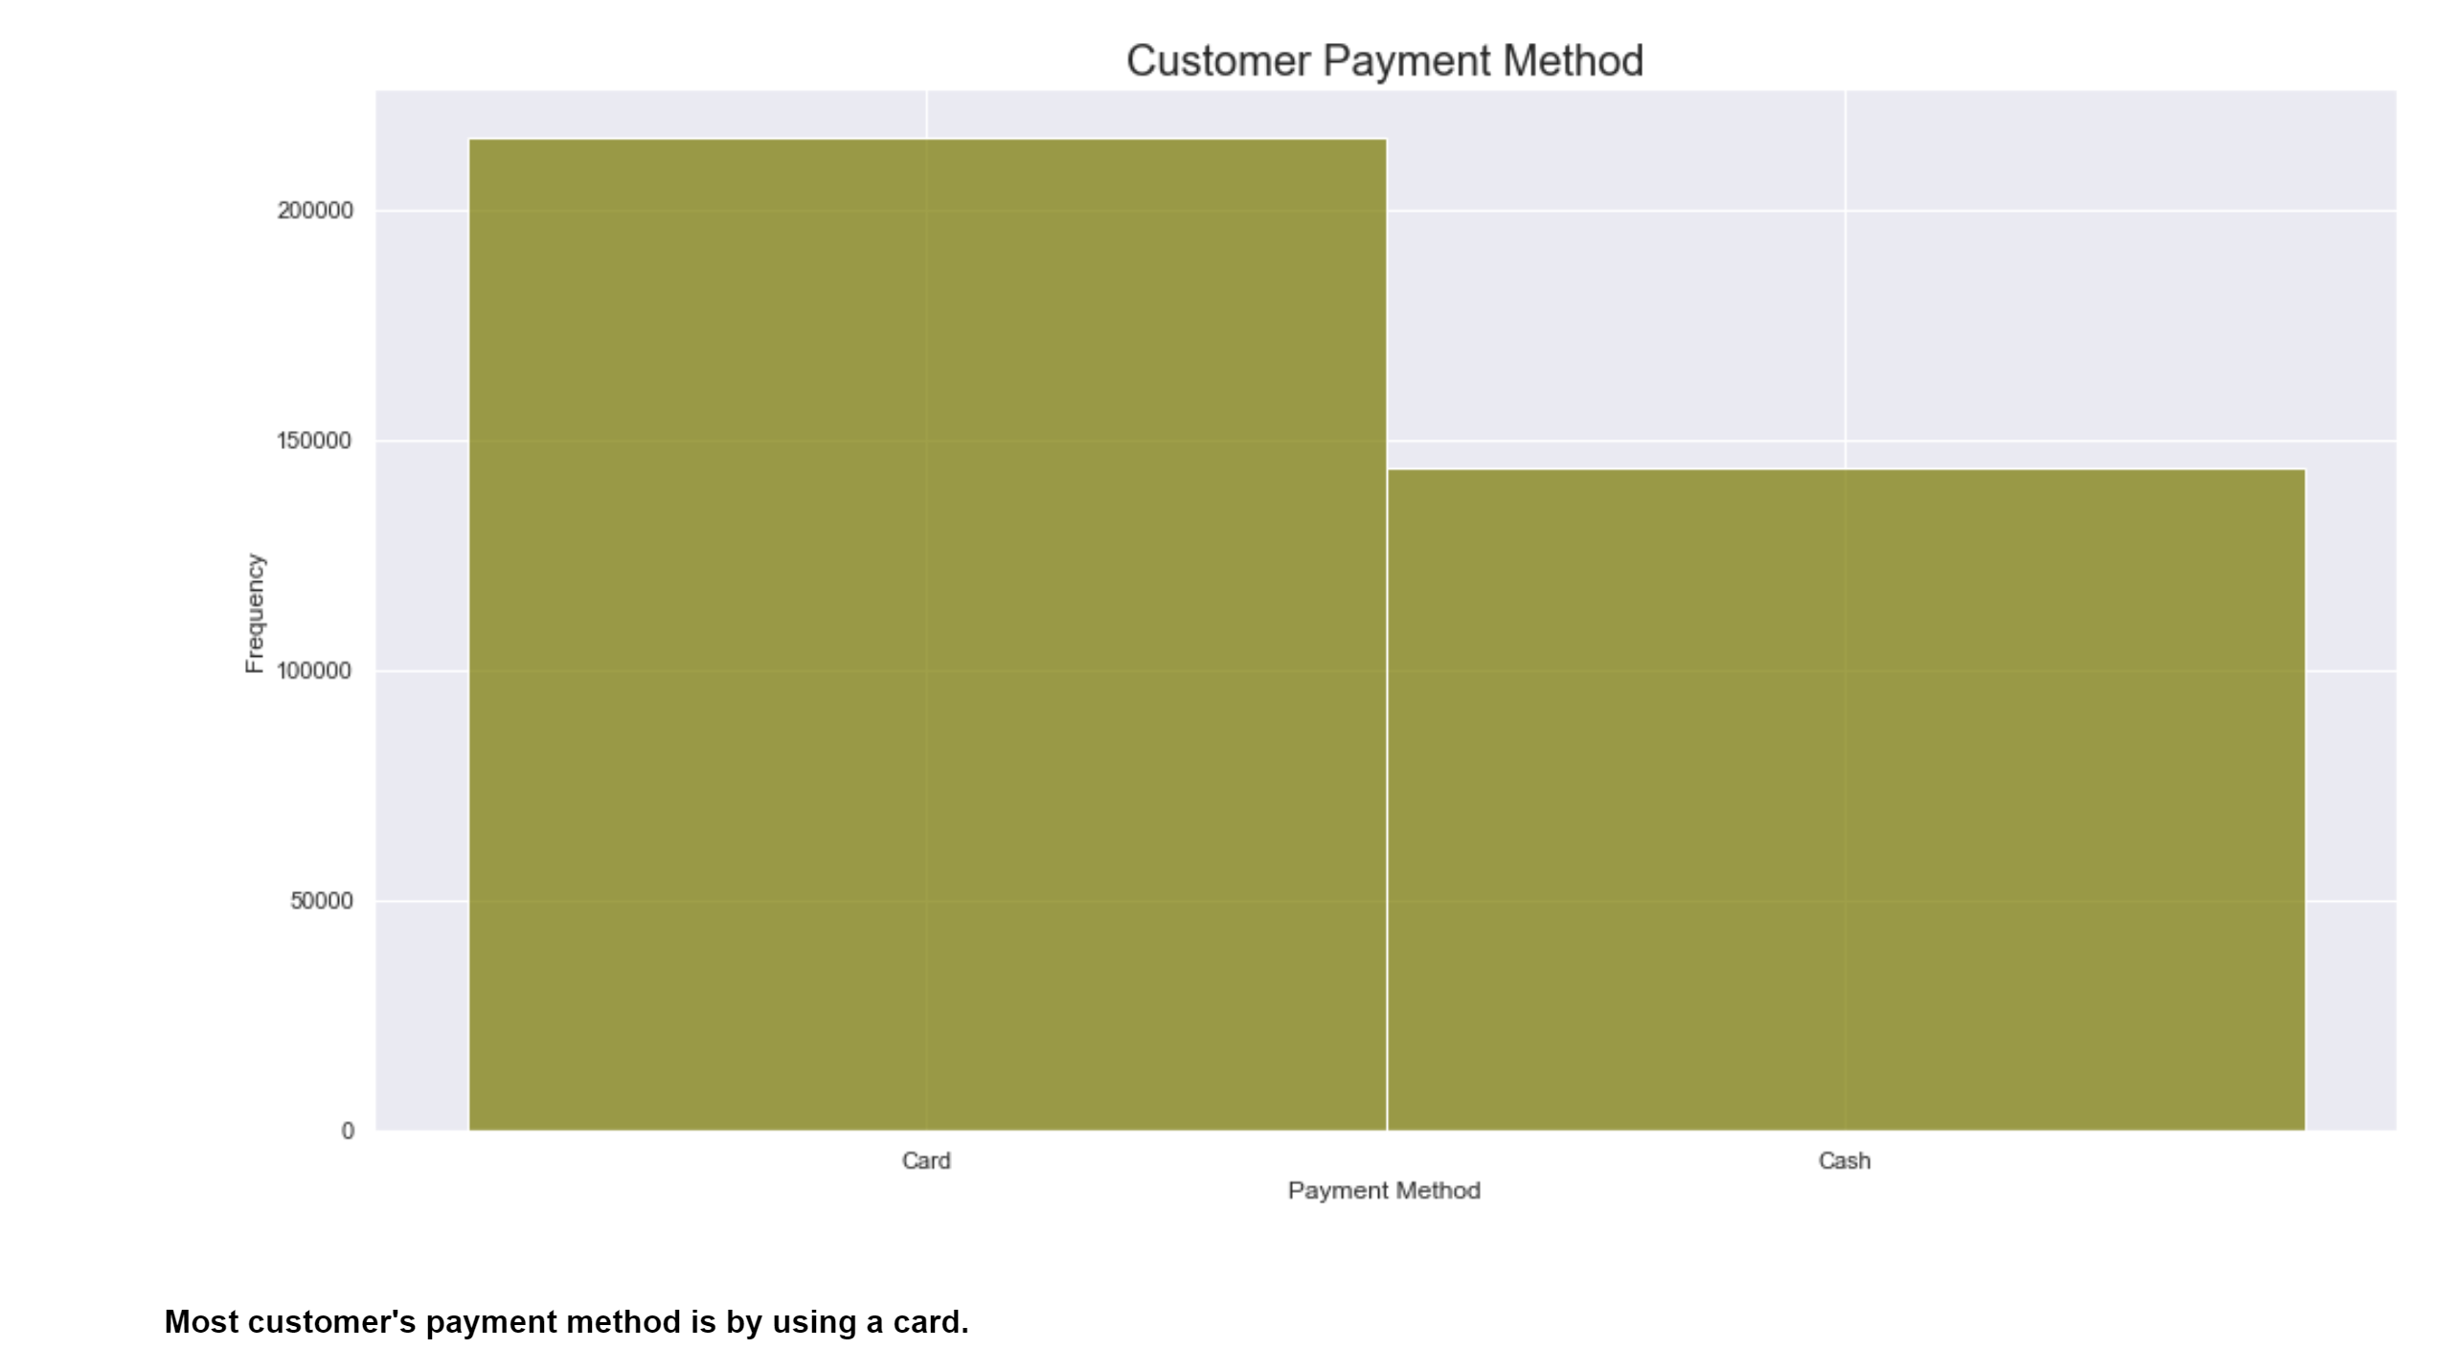
Method of Payment

Slide 10
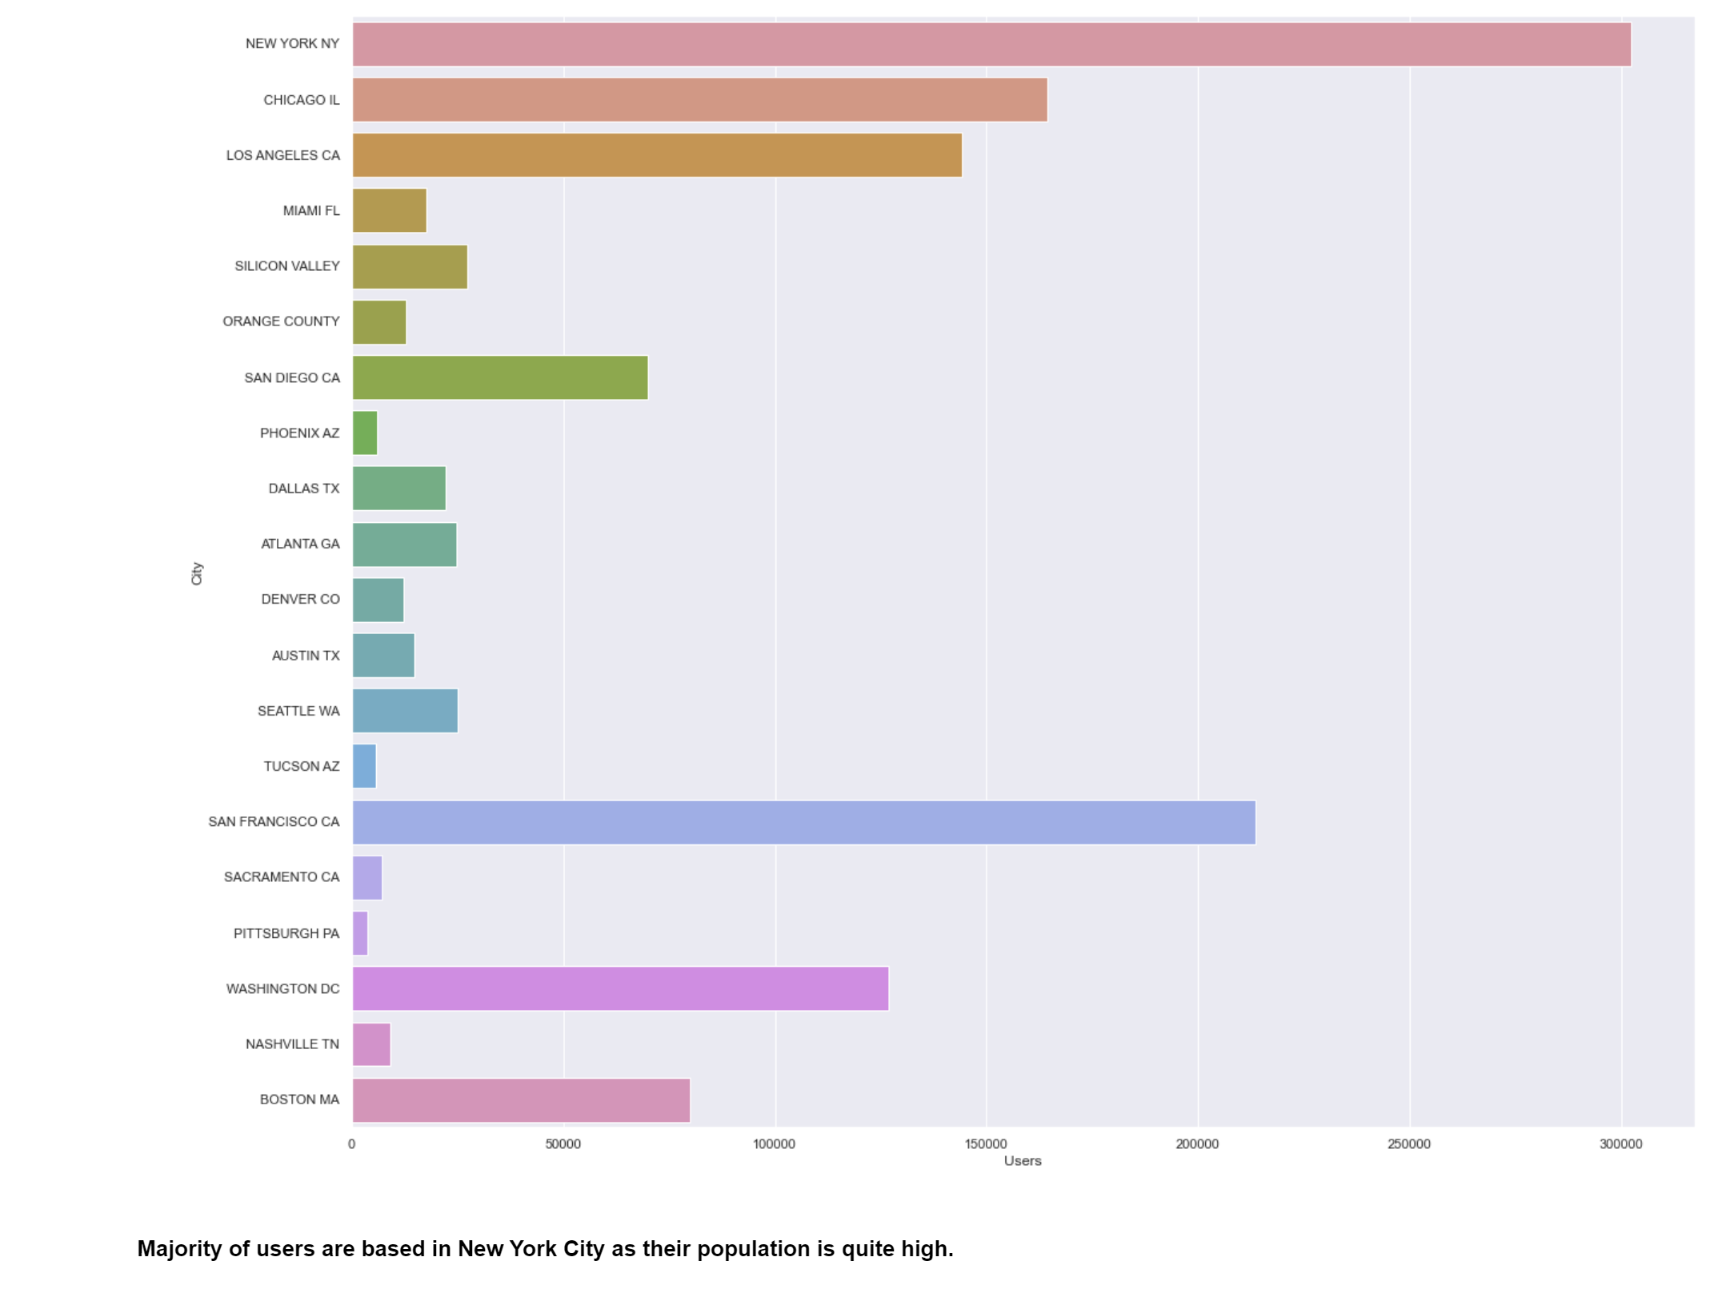
Users Per City

Slide 11
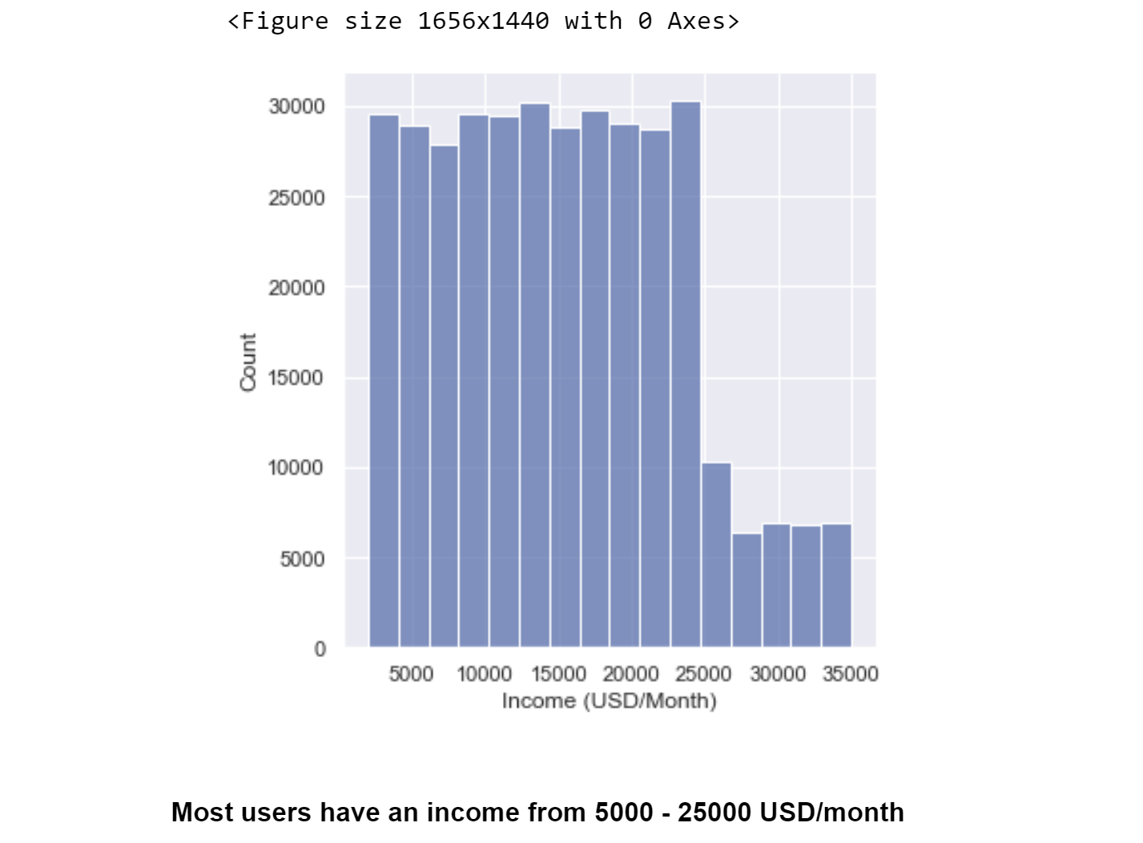
Customer Income Distribution

Slide 12
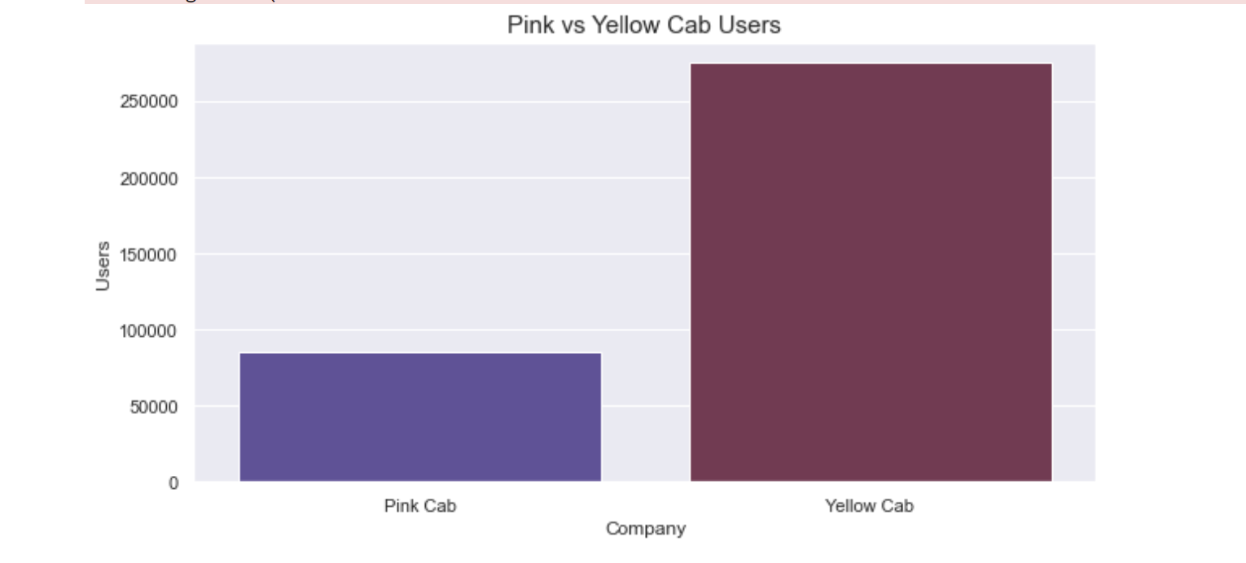
Pink Cab Users vs Yellow Cab Users
Yellow Cab has significantly more cab users than Pink Cab

Slide 13
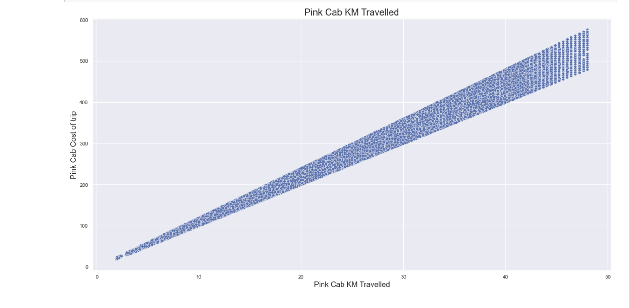
Pink Cab KM Travelled

Slide 14
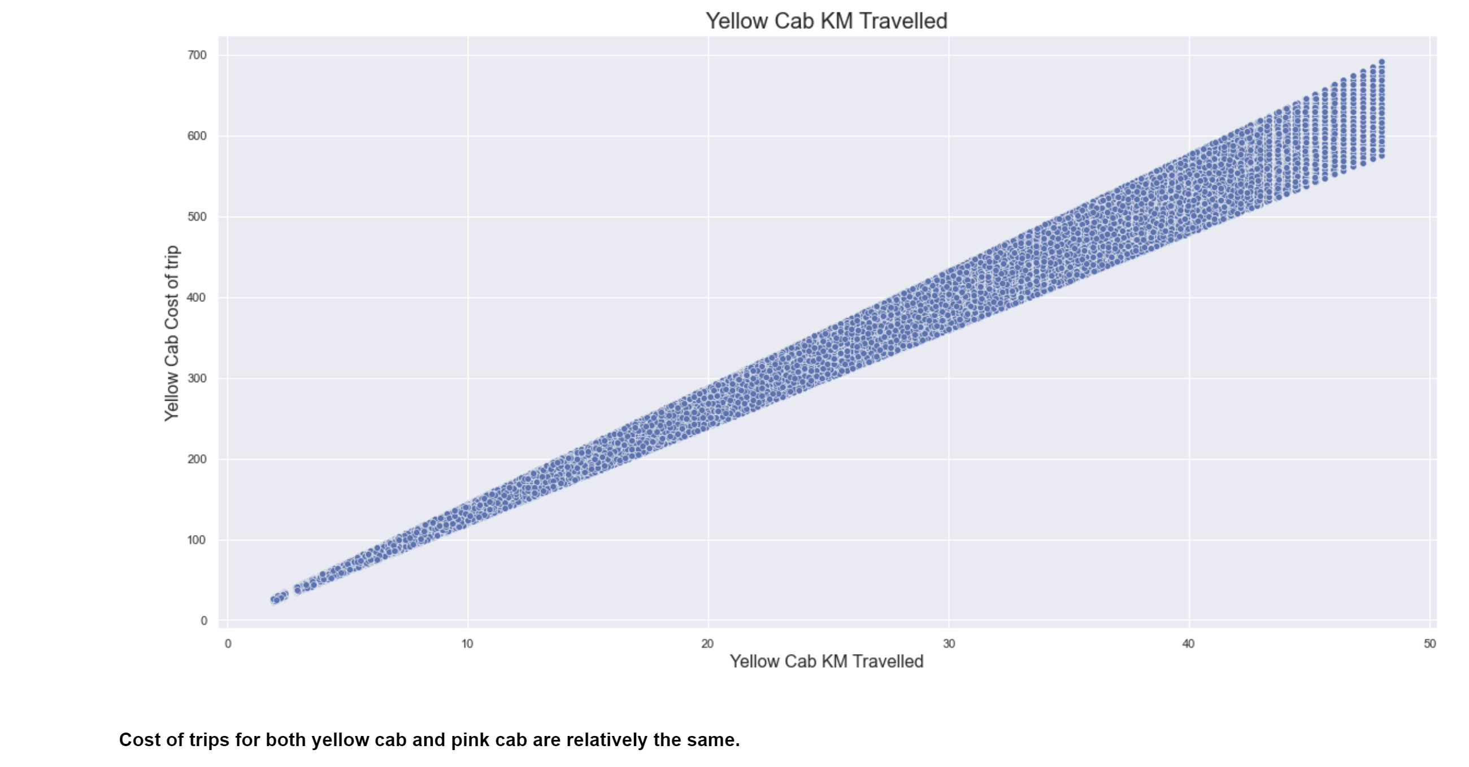
Yellow Cab KM Travelled

Slide 15
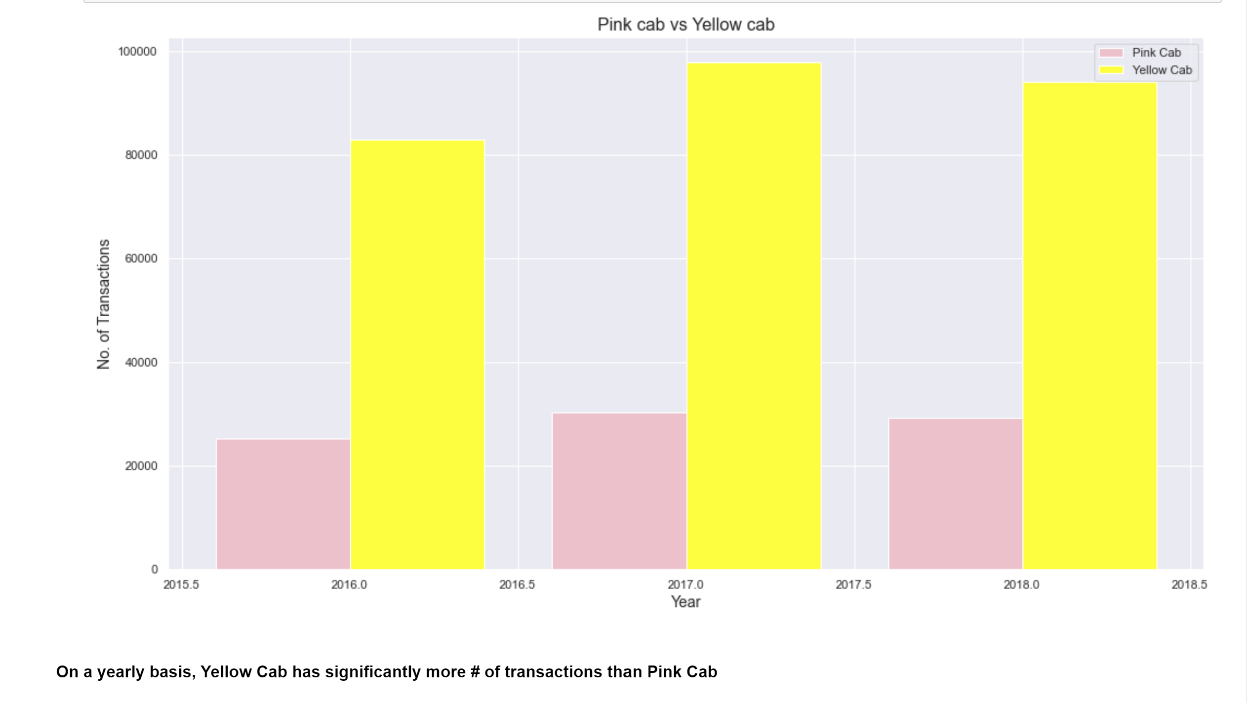
Number of Yearly Transactions per Company

Slide 16
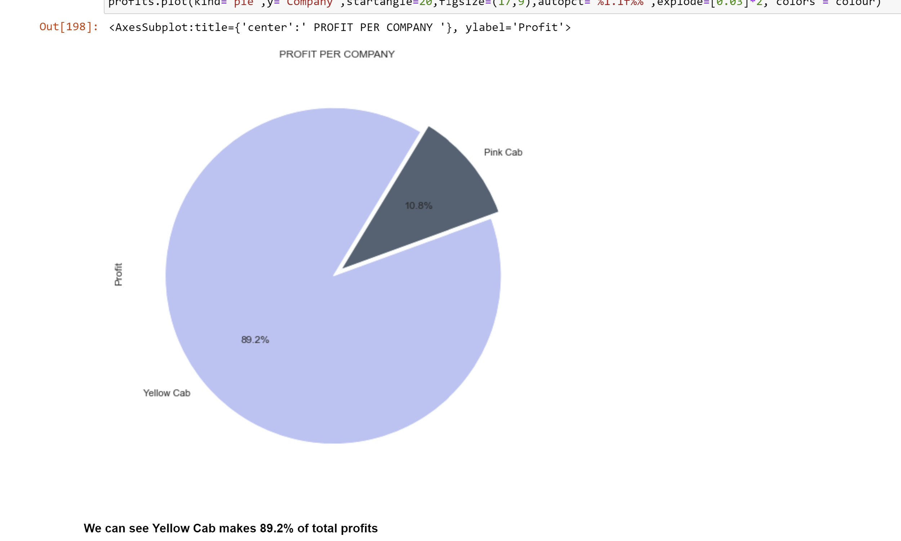
Pink Cab vs Yellow Cab Total Profit Percentile

Slide 17
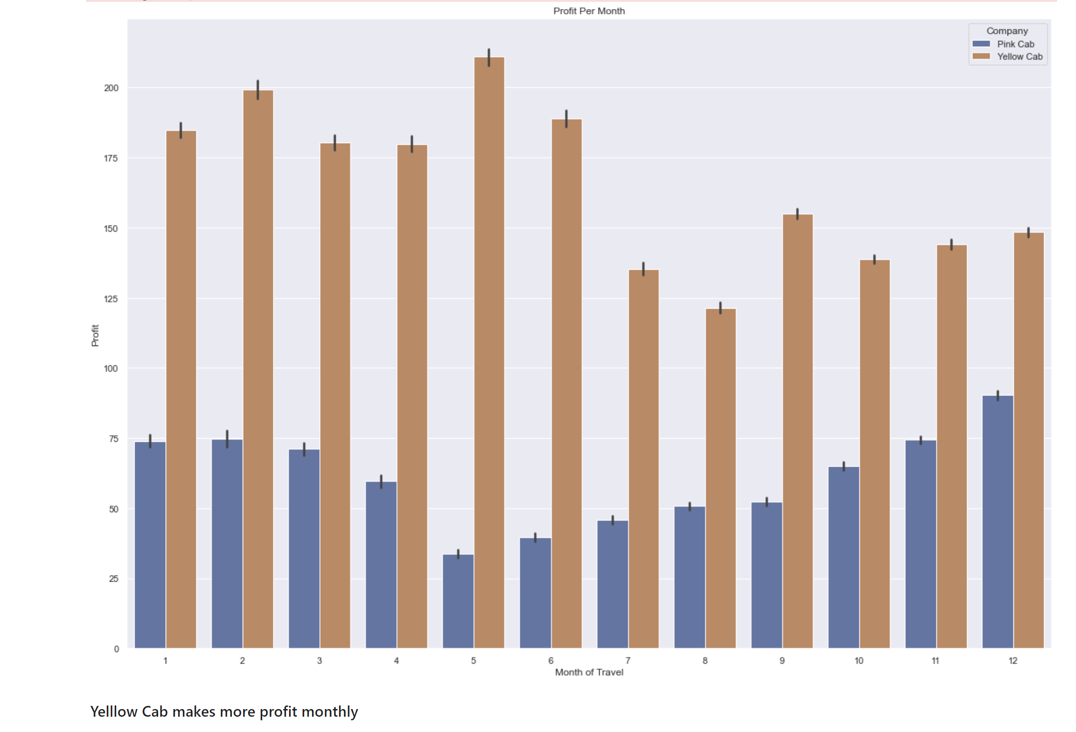
Profit per Month (Pink Cab vs Yellow Cab)

Slide 18
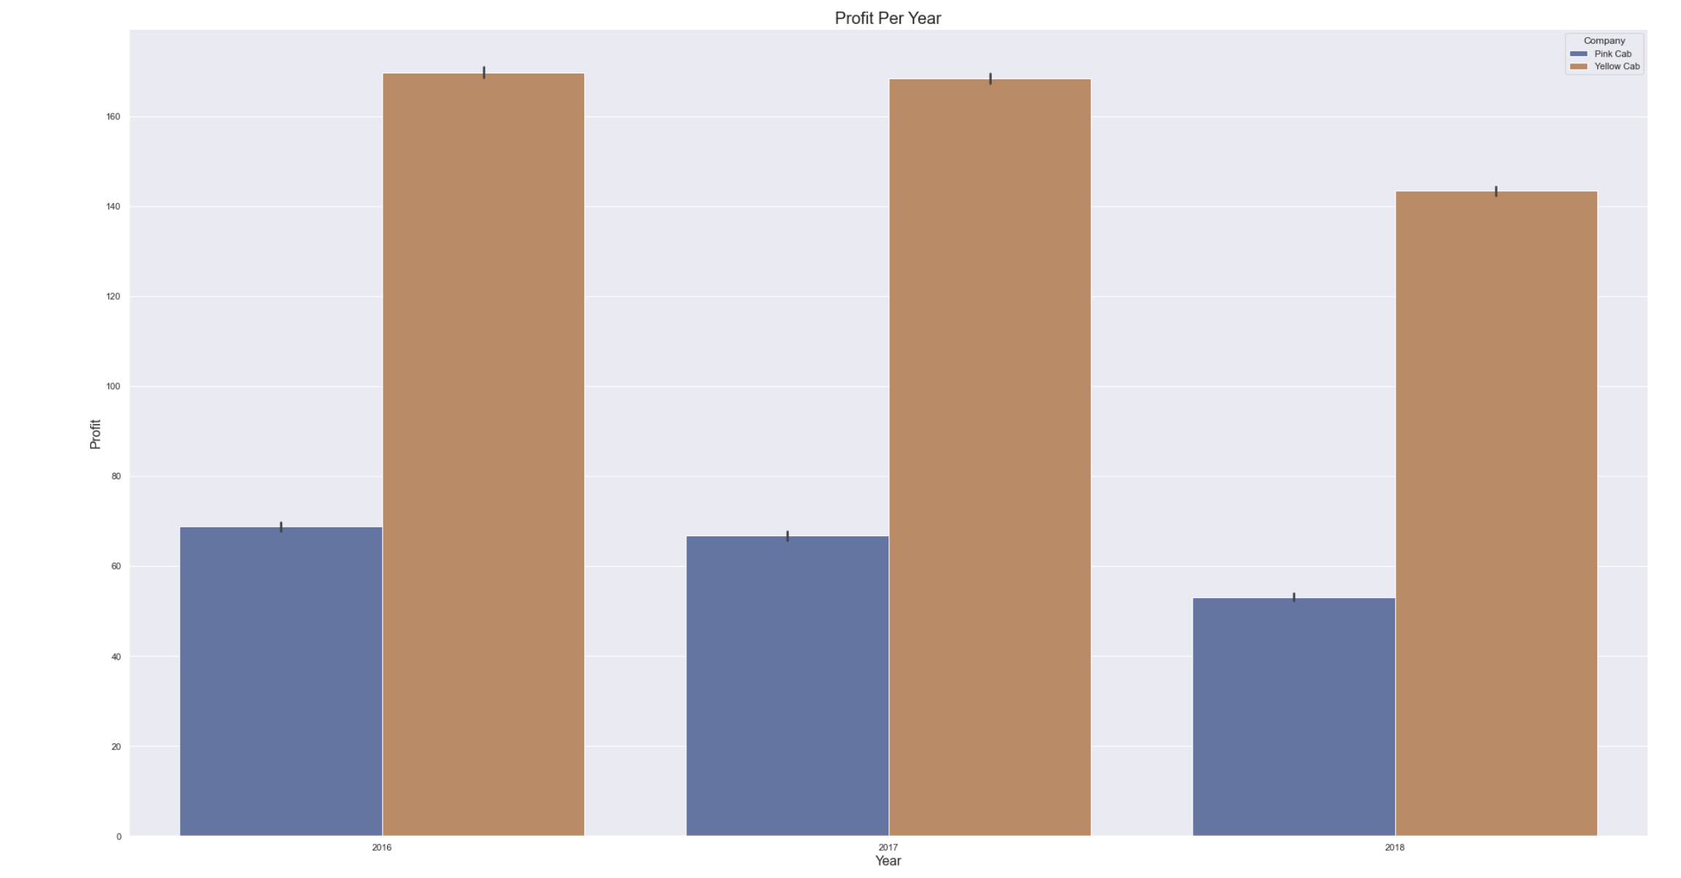
Profit per Year (Pink Cab vs Yellow Cab)
Yellow Cab has more profit years than Pink Cab

Slide 19
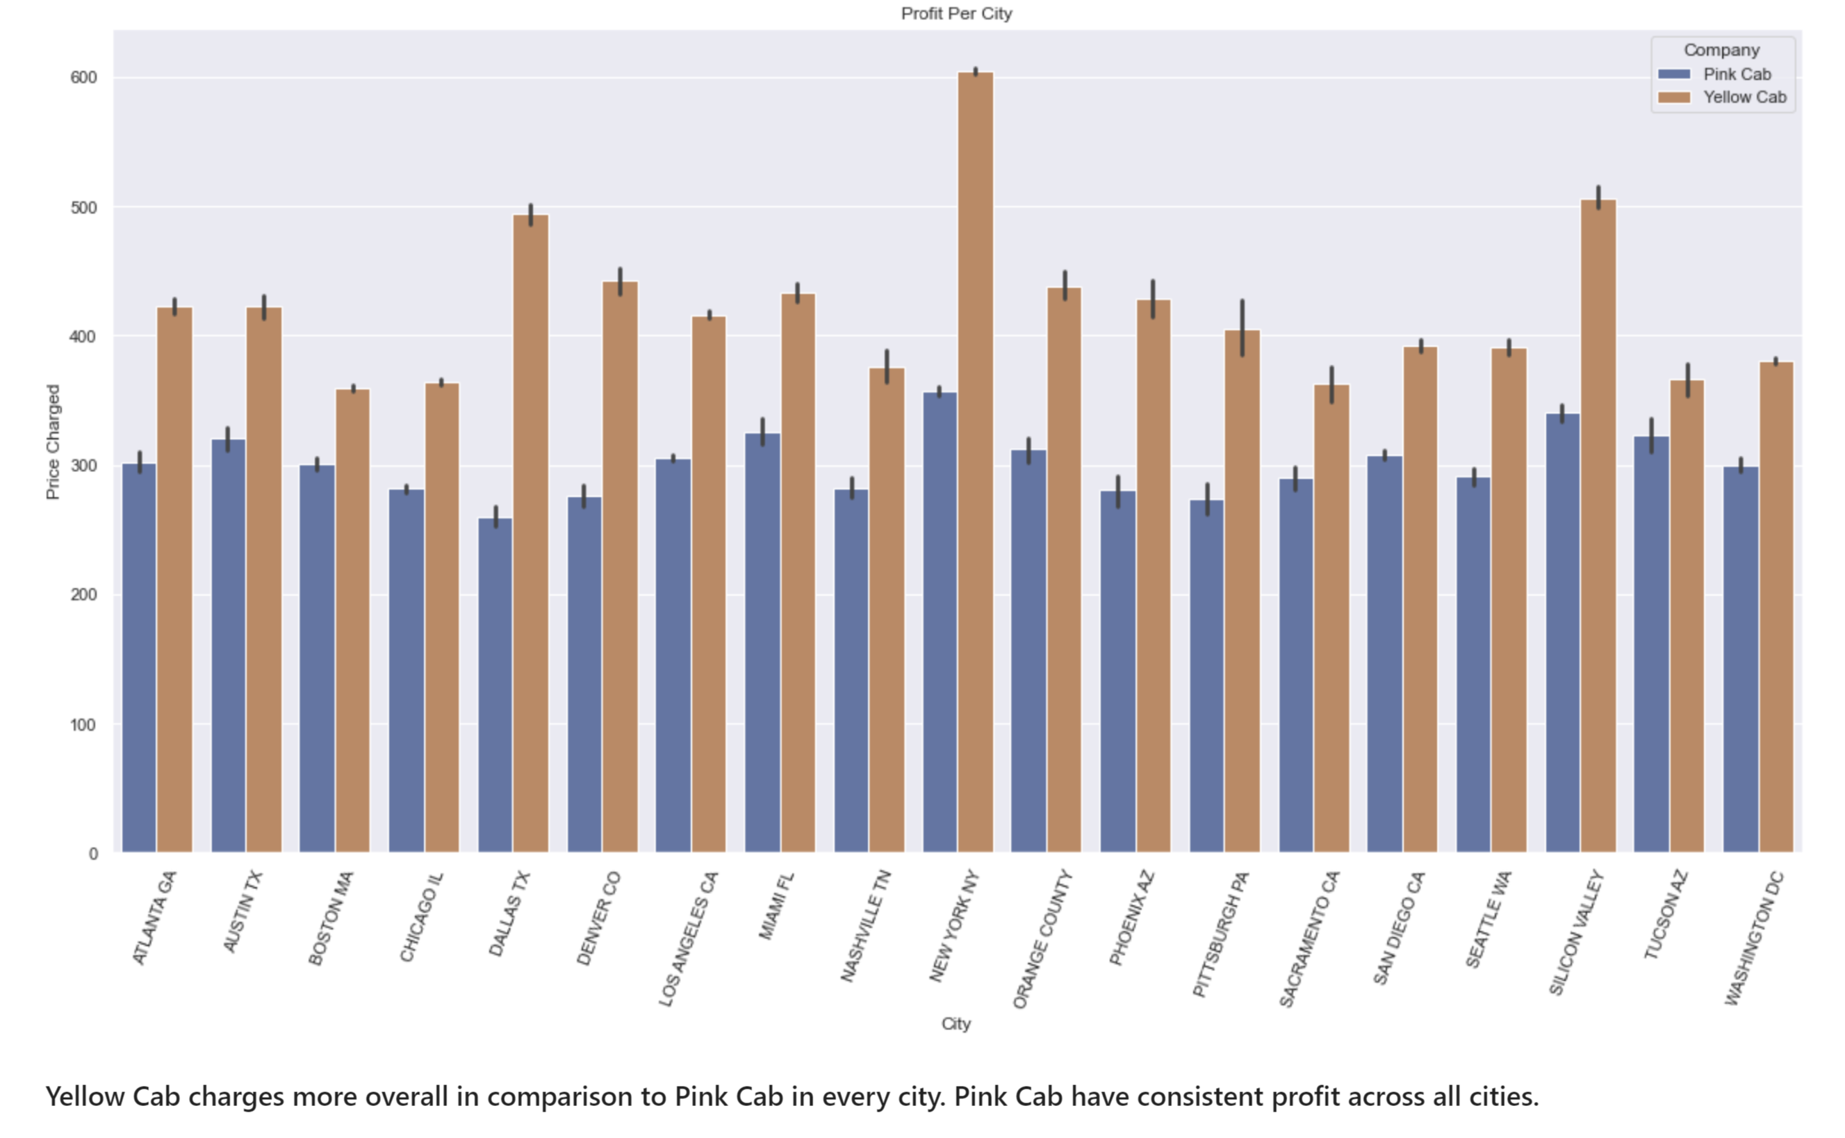
Profit per City (Pink Cab vs Yellow Cab)

Slide 20
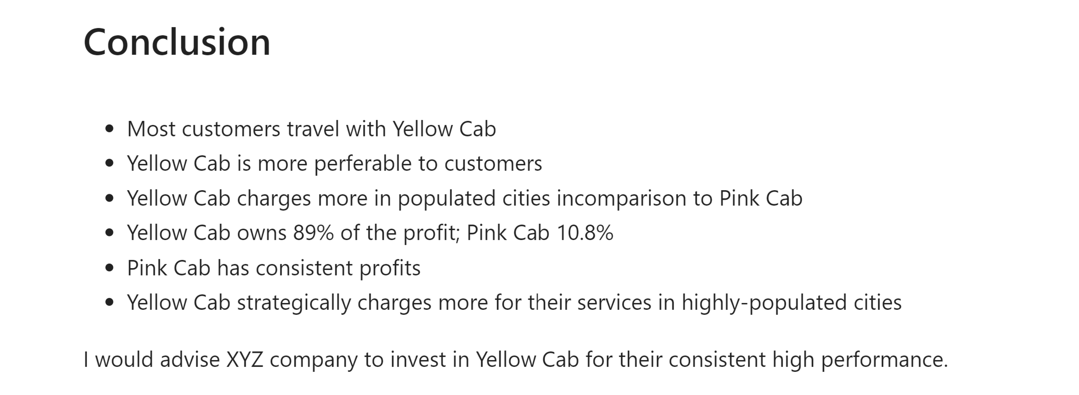
EDA Summary & Recommendations

